Slide 1

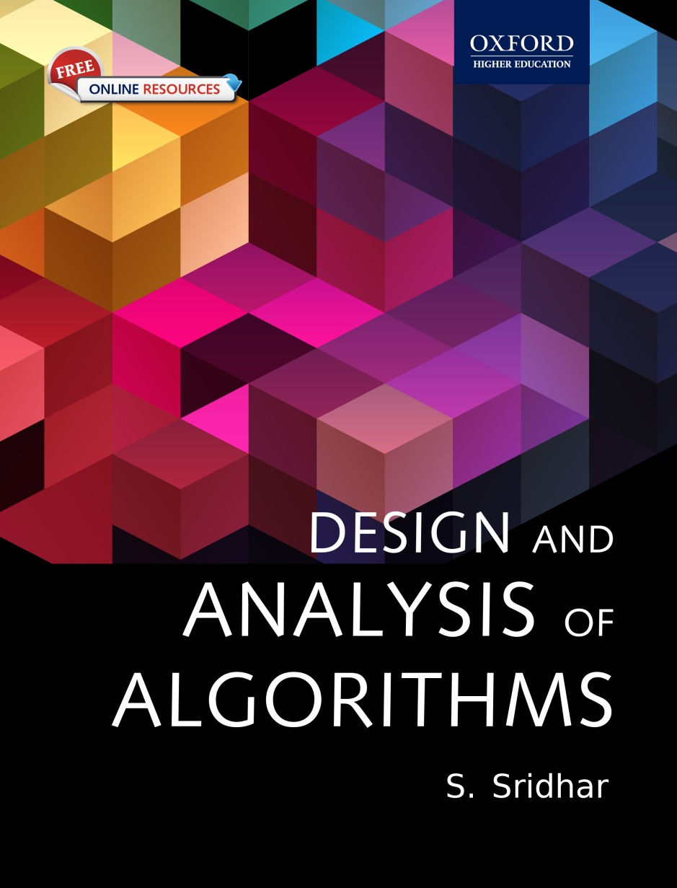
Design and Analysis of Algorithms
S. Sridhar

Slide 2
Chapter 2
Basics of Algorithm Writing

Slide 3
Chapter Objectives

Slide 4
What is Stepwise refinement?
An algorithm is a set of instructions to solve a given problem.

Slide 5
Advantages of Stepwise refinement

Slide 6
Disadvantages of Stepwise refinement

Slide 7
Top-down Example

Slide 8
Bottom-up Design

Slide 9
Comparisons

Slide 10
Structured Programming Structures

Slide 11
Selection

Slide 12
Repetition

Slide 13
Algorithm Design

Slide 14
Block Structure

Slide 15
If-then-else Statement

Slide 16
Case Statement

Slide 17
Repeat Statement

Slide 18
Repeat Statement

Slide 19
Break Statement

Slide 20
Return Statement

Slide 21
Recursive Algorithms

Slide 22
Example Algorithms-Pay calculations

Slide 23
Example 2-Fahrenheit to Celsius conversion

Slide 24
Example 3-Armstrong number

Slide 25
Armstrong Number Algorithm

Slide 26
Another Example-Euclid algorithm

Slide 27
Encryption Algorithm

Slide 28
Encryption Algorithm

Slide 29
Algorithm

Slide 30
Recursive Algorithm

Slide 31
Fibonacci Numbers

Slide 32
Collatz Numbers

Slide 33
Collatz Numbers

Slide 34
Towers of Hanoi Algorithms

Slide 35
Algorithm

Slide 36
Progress Correctness

Slide 37
Proof Procedure

Slide 38
Glossary

Slide 39
Glossary - 2
Glossary

